Slide 1
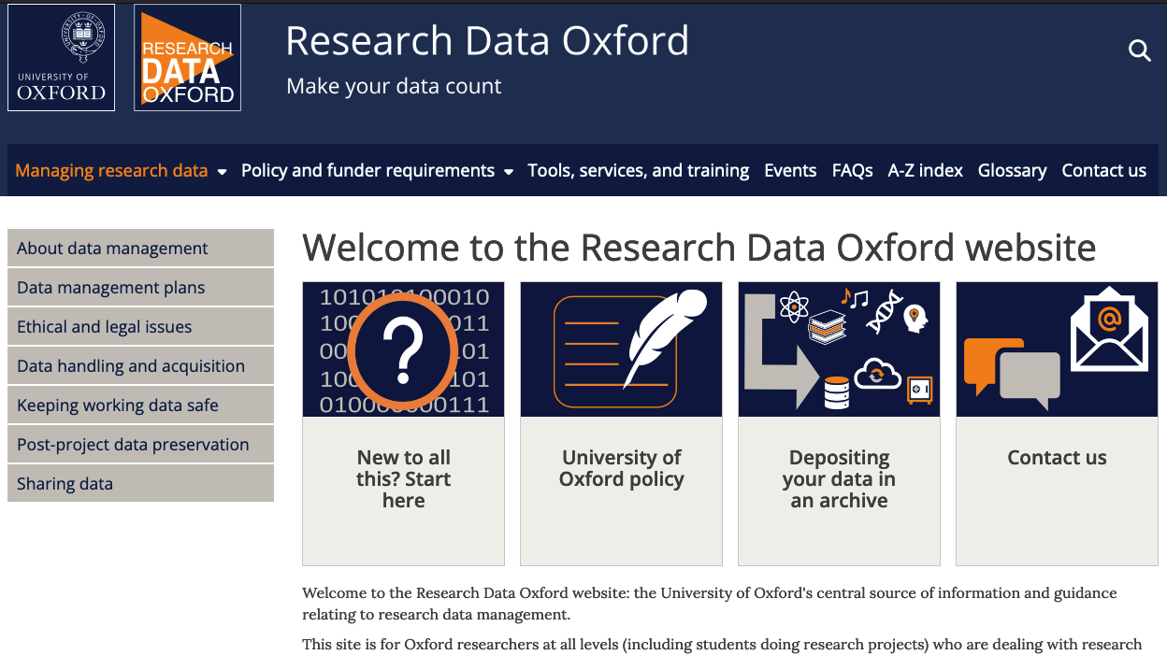

Research Data Oxford
Data management plans
Funder requirements
Storage and back-up
Preservation and sharing
Personal and sensitive data
Tools, services, and training
  https://researchdata.ox.ac.uk
  researchdata@ox.ac.uk
Notes:
The Research Data Oxford website aims to be a one-stop-shop for information and guidance about research data management.
For personalised advice, queries can be sent to researchdata@ox.ac.uk.
This slide was prepared by the Research Data Oxford team, and is made available under the Creative Commons Attribution Non-Commercial License: https://creativecommons.org/licenses/by-nc/4.0/. Subject to the terms of the license, you are welcome to reuse or adapt this material for your own purposes. Last updated in September 2024.

